Slide 1
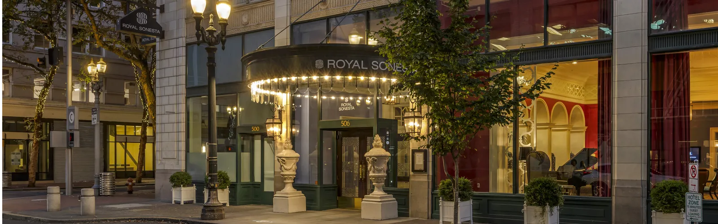
STRATEGIC ACQUISITION & PARTNERSHIP PROPOSAL
The Royal Sonesta
Portland Downtown
A long-term proposal to recapitalize the property, preserve the Royal Sonesta identity and restore competitive performance.
Presented by MyntGroup PLC • August 2026
MYNTGROUP PLC | CONFIDENTIAL — NON-BINDING DISCUSSION MATERIALS
01
Notes:
[Sources]
Hotel imagery: https://www.sonesta.com/royal-sonesta/or/portland/royal-sonesta-portland-downtown
[/Sources]
All transaction terms are indicative and subject to due diligence, approvals and definitive documentation.

Slide 2
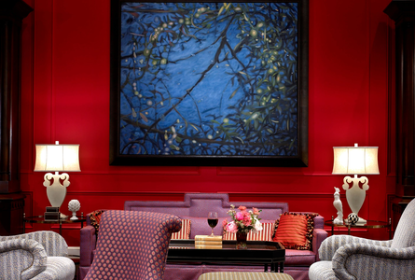
OUR INTENT
A clean transaction today — and a platform for a longer relationship
MyntGroup proposes to acquire or partner around the Portland property through a ring-fenced ownership structure, with capital dedicated to stabilization and long-term value creation.
The objective is not simply to buy an asset at a discount. It is to remove an ongoing burden, maintain brand continuity and establish a repeatable partnership for additional non-core opportunities.
LONG-TERM STEWARDSHIP
Brand continuity • dedicated capital • transparent governance
MYNTGROUP PLC | CONFIDENTIAL — NON-BINDING DISCUSSION MATERIALS
02
Notes:
[Sources]
Hotel imagery: https://www.sonesta.com/royal-sonesta/or/portland/royal-sonesta-portland-downtown
[/Sources]
All transaction terms are indicative and subject to due diligence, approvals and definitive documentation.

Slide 3
ALIGNED OUTCOMES
The proposal is designed around the priorities of both owner and brand
01
02
03
Service Properties Trust
Sonesta
MyntGroup
A certain, documented path to transfer the asset and eliminate future operating exposure.
Continuity of flag and management economics, supported by a new capitalization plan.
A flagship hospitality asset and the foundation for a wider acquisition partnership.
The preferred structure should preserve optionality: outright sale, strategic rollover or a broader portfolio relationship.
MYNTGROUP PLC | CONFIDENTIAL — NON-BINDING DISCUSSION MATERIALS
03
Notes:
[Sources]
Owner/operator identification: Monthly STAR_33032-20251000-USD-E-live (1).xlsx, Glance sheet, attached to the transaction review.
[/Sources]
All transaction terms are indicative and subject to due diligence, approvals and definitive documentation.

Slide 4
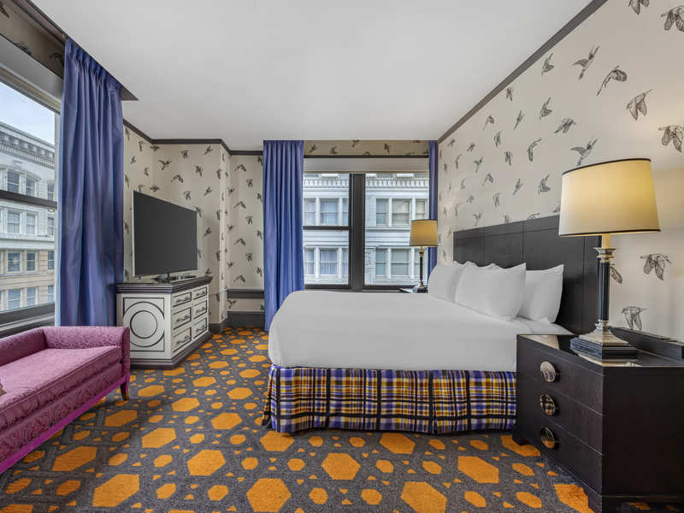
THE PROPERTY
A substantial downtown asset with an unusually high suite mix
221
135
guest rooms / keys
suites — approximately 61% of keys
≈18,580 m²
8,000+ sq. ft.
gross building area
meeting and event space
506 SW Washington
downtown Portland address
Formerly Kimpton Hotel Monaco Portland • currently Royal Sonesta
MYNTGROUP PLC | CONFIDENTIAL — NON-BINDING DISCUSSION MATERIALS
04
Notes:
[Sources]
Property details: https://www.sonesta.com/royal-sonesta/or/portland/royal-sonesta-portland-downtown
Building area: https://www.portland.gov/bps/climate-action/energy-reporting/documents/2016-energy-performance-information-individual/download
Suite count of 135 supplied in seller materials; to be confirmed in due diligence.
[/Sources]
All transaction terms are indicative and subject to due diligence, approvals and definitive documentation.

Slide 5
TRANSACTION CONTEXT
The proposed basis is a fraction of the property’s documented 2016 acquisition price
$58,824
proposed price per key
≈$700/m²
proposed price per gross m²
Historical price is context — not a representation of current value. Current value remains subject to appraisal, condition, title and operating diligence.
MYNTGROUP PLC | CONFIDENTIAL — NON-BINDING DISCUSSION MATERIALS
05
Notes:
[Sources]
2016 acquisition: https://s2.q4cdn.com/208827006/files/doc_presentations/2016/HPT_Investor-Presentation-_3Q16_FINAL.pdf
Proposed $13m price is seller-provided and subject to definitive agreement.
[/Sources]
All transaction terms are indicative and subject to due diligence, approvals and definitive documentation.

Slide 6
PERFORMANCE DIAGNOSIS
The Portland market is operating — the property is not capturing its fair share
2025 YTD
37.0%
occupancy vs. 60.0% comp set
$110.22
ADR vs. $127.21 comp set
$40.79
RevPAR vs. $76.34 comp set
The property ranked 6th of 6 on occupancy and RevPAR.
MYNTGROUP PLC | CONFIDENTIAL — NON-BINDING DISCUSSION MATERIALS
06
Notes:
[Sources]
Source: Monthly STAR_33032-20251000-USD-E-live (1).xlsx, Glance, Summary and Comp sheets. Competitive-set data excludes the subject property.
[/Sources]
All transaction terms are indicative and subject to due diligence, approvals and definitive documentation.

Slide 7
RECOVERY OPPORTUNITY
Closing the competitive gap creates a measurable revenue path
Room revenue potential at current key count
+$2.87m
annual room-revenue gap if the property reaches competitive-set RevPAR
The opportunity is operational: rebuild transient demand, improve channel mix, reprice suites and use meeting space to drive room nights.
MYNTGROUP PLC | CONFIDENTIAL — NON-BINDING DISCUSSION MATERIALS
07
Notes:
[Sources]
Source inputs: Monthly STAR_33032-20251000-USD-E-live (1).xlsx, 2025 YTD RevPAR; calculation assumes 221 keys and 365 available nights. Illustrative, not a forecast.
[/Sources]
All transaction terms are indicative and subject to due diligence, approvals and definitive documentation.

Slide 8
INDICATIVE STRUCTURE
A brand-supported capital stack can create a credible path to closing
Seller financing | $7.0m
Interest | 6.0–6.5%
Amortization | Interest-only
Initial term | 24 months
Closing capital | $6.0m to be arranged by Mynt
$13m
PROPOSED PURCHASE PRICE
Subject to capital commitments, diligence, approvals and definitive documentation.
MYNTGROUP PLC | CONFIDENTIAL — NON-BINDING DISCUSSION MATERIALS
08
Notes:
[Sources]
Proposed transaction terms supplied by the user and not independently verified. No statement of committed funding is made in this presentation.
[/Sources]
All transaction terms are indicative and subject to due diligence, approvals and definitive documentation.

Slide 9
FIRST 24 MONTHS
A disciplined stabilization plan begins before closing
01
02
03
04
Confirm
Protect
Recover
Refinance
Title, condition, PIP, contracts, capital needs and definitive financing.
Maintain brand continuity, service standards and operational stability.
Rebuild transient demand, suite pricing, distribution and group conversion.
Establish positive cash flow and a credible long-term capital structure.
Target outcome: a stable asset capable of supporting long-term debt and continued Sonesta affiliation.
MYNTGROUP PLC | CONFIDENTIAL — NON-BINDING DISCUSSION MATERIALS
09
Notes:
[Sources]
Stabilization plan is indicative and subject to management access, diligence and an approved operating budget.
[/Sources]
All transaction terms are indicative and subject to due diligence, approvals and definitive documentation.

Slide 10
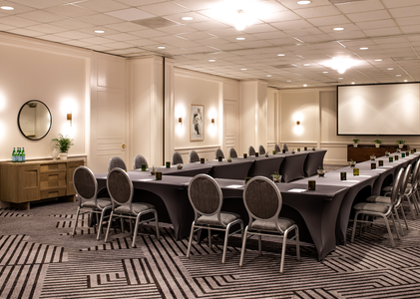
BRAND CONTINUITY
The proposed partnership is designed to protect Sonesta’s position
01
Preserve the flag
Maintain Royal Sonesta identity through the stabilization period.
02
Fund the recovery
Ring-fence acquisition and operating capital at property level.
03
Build a pipeline
Use Portland as the first discussion in a wider non-core asset relationship.
MYNTGROUP PLC | CONFIDENTIAL — NON-BINDING DISCUSSION MATERIALS
10
Notes:
[Sources]
Hotel imagery and brand/property information: https://www.sonesta.com/royal-sonesta/or/portland/royal-sonesta-portland-downtown
[/Sources]
All transaction terms are indicative and subject to due diligence, approvals and definitive documentation.

Slide 11
PARTNERSHIP OPTIONS
One property can support three practical paths forward
Structure | What it delivers | Potential continuing relationship
Outright acquisition | A defined sale with seller financing and brand continuity. | Sonesta remains brand/operator under agreed terms.
Strategic rollover | A portion of value remains as seller debt or preferred participation. | Shared upside from stabilization.
Portfolio relationship | Portland becomes the first transaction in a repeatable framework. | Mynt evaluates additional non-core assets.
MyntGroup’s preference is to agree the structure that provides the greatest certainty and best long-term alignment.
MYNTGROUP PLC | CONFIDENTIAL — NON-BINDING DISCUSSION MATERIALS
11
Notes:
[Sources]
All structures are discussion alternatives only and are subject to legal, tax, accounting, regulatory and financing review.
[/Sources]
All transaction terms are indicative and subject to due diligence, approvals and definitive documentation.

Slide 12
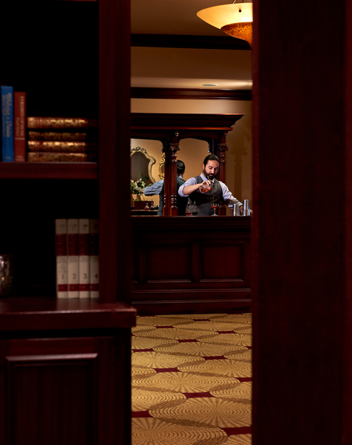
PROPOSED NEXT STEP
Move into a focused, confidential transaction process
1 Confirm access to property, financial and contractual diligence
2 Align an indicative term sheet and capitalization plan
3 Establish a timetable toward exclusivity and definitive documents
Björgvin Þ. Þorsteinsson | Chairman & CEO | MyntGroup PLC
MYNTGROUP PLC | CONFIDENTIAL — NON-BINDING DISCUSSION MATERIALS
12
Notes:
[Sources]
Hotel imagery: https://www.sonesta.com/royal-sonesta/or/portland/royal-sonesta-portland-downtown
[/Sources]
All transaction terms are indicative and subject to due diligence, approvals and definitive documentation.

